Slide 1
Introducing a new wheel/ rail profile
San Francisco Bay Area Rapid Transit
June 10, 2017

Slide 2
BART System Overview
  Began operation in 1972
  Currently 669 revenue vehicles
  110 miles (168 km) mainline
  46 stations
  Hybrid commuter- metro
  430,000 weekday riders
  Full ATC
  80 mph (129 km/h) top speed
  1000 VDC 3rd rail
  5.5 ft (1676 mm) wide gauge track
  Full dedicated right of way
  3 mile (4.8 km) dedicated test track

Slide 3
BART Existing Fleet Overview
  669 heavy rail cars
  Lead Cars – 289
    59 A2 Rohr/ Bombardier cars
    150 C1 Alstom cars
    80 C2 Morrison Knudsen cars
  Mid consist cars – 380
    380 B2 Rohr/ Bombardier cars
  2 door openings per side
  60 & 56 seats per car
  615 ft2 (57 m2) & 655 ft2 (61 m2) interior area
  70 ft (21.3 m) x 10 ft (3.2 m)
  63k lb (28.6 t) empty car – super light weight
  110k lb (49.9 t) max car weight – civil limited

Slide 4
Unique Vehicle Characteristics
  Full lightweight aluminum car body structure
  Wide gauge for improved ride and roll stiffness
  Low roof line for compact frontal area
  Lightweight aluminum wheels for low rotational inertia
  1k VDC operation for lower operating currents
  Full regeneration capability for maximum efficiency
  Advanced crash energy management design

Slide 5
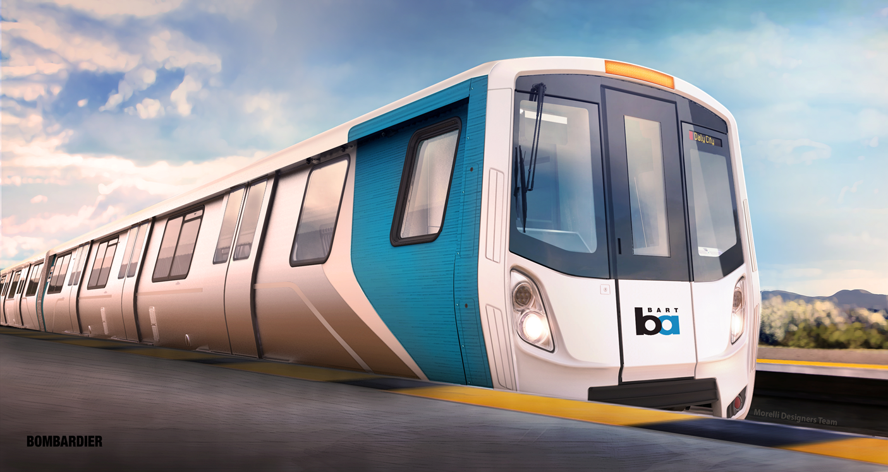
New Cars – Fleet of the Future
  Contract with Bombardier Transportation, May 30, 2012
  775 cars, includes 310 “D” cab cars and 465 “E” mid consist cars
  10 pilot cars in non‐revenue testing, production cars in 2017
  Transition phase with both fleets in operation – approx. 10 years
  Performance specification – optimize new car without constraint to existing fleet

Slide 6
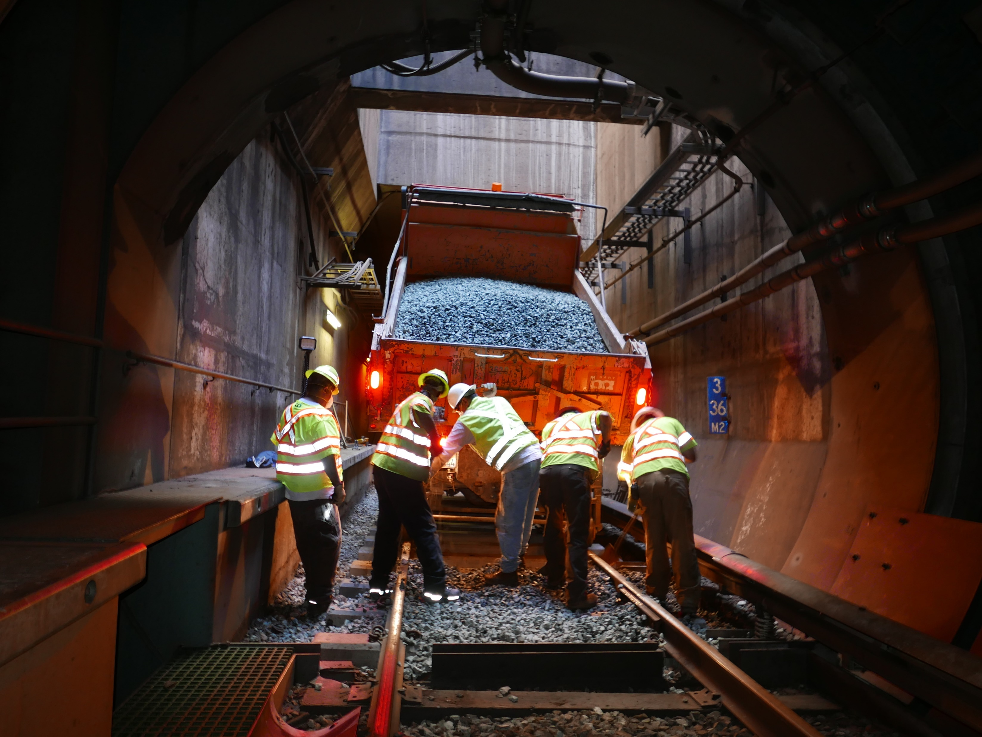
BART Rail System Overview
  110 route miles of track
    235 mainline track miles
    28% aerial direct fixation
      36” fastening spacing
    27% subway direct fixation
      36” fastening spacing
    45% at-grade ballasted
      (concrete/ wood/ composite ties)
      30” tie spacing
    45 interlockings/ 322 mainline turnouts
    119RE continuous welded rail
    Custom trackwork for cylindrical profile
      Level point frog

Slide 7
Why a Cylindrical Wheel Profile?
  Not uncommon at the time – SF Muni, CTA, PATH
  Mostly Tangent Track
  High Speed – 80 mph
  No hunting at high speed on tangent track
  Ride quality with new wheels and new rail is good
  Expected 1,000,000 mile wheel life
    Condemned on #8 flange
    Wheel lathe not milling

Slide 8
Problems with Cylindrical Profile
  Flange steering/ No inherent wheelset steering through curves
  2 point contact prevalent as wheel and rail wear
  Systematic corrugation growth on direct fixation track, accentuated in curves
  Areas with corrugation are unbearably noisy
    Reverberation in tunnels results in resonating howling noise inside cars
    Noise from elevated track floods surrounding neighborhoods with noise
  Severe wheel flange wear results in shorted wheel life
  Severe rail head wear particularly in sharp curves is difficult to grind
  High material and maintenance costs

Slide 9
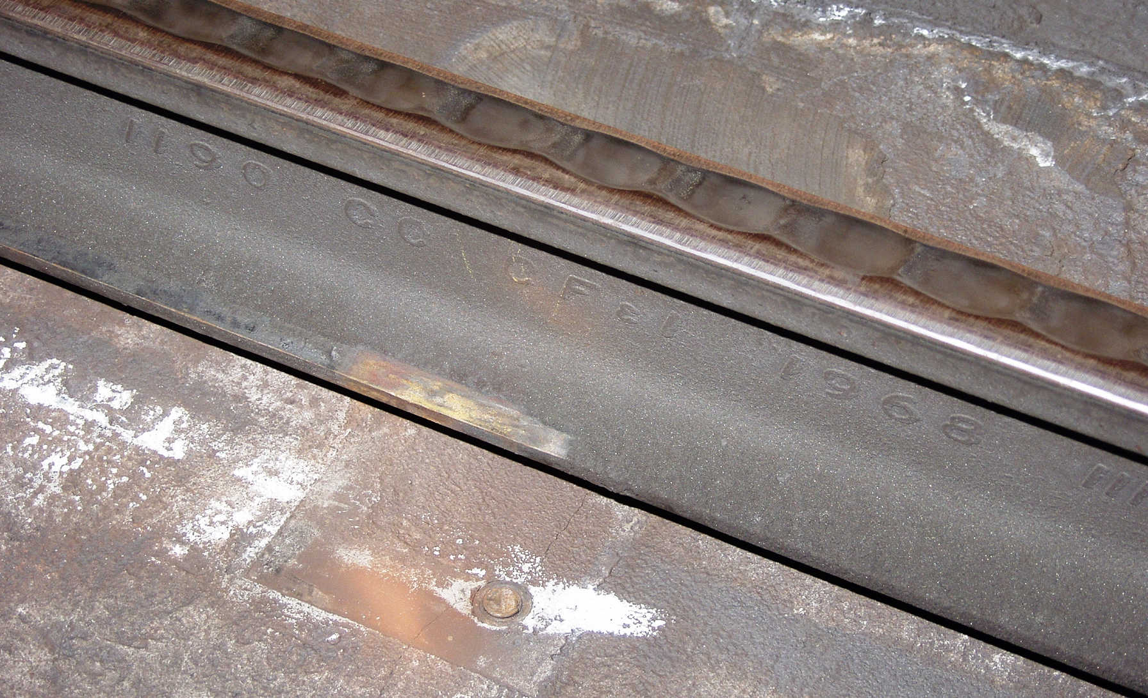
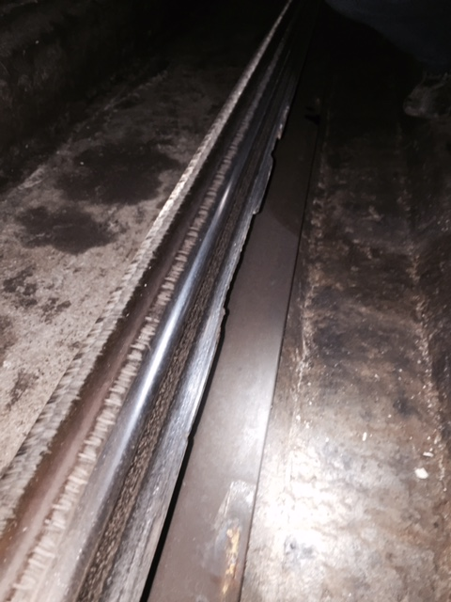
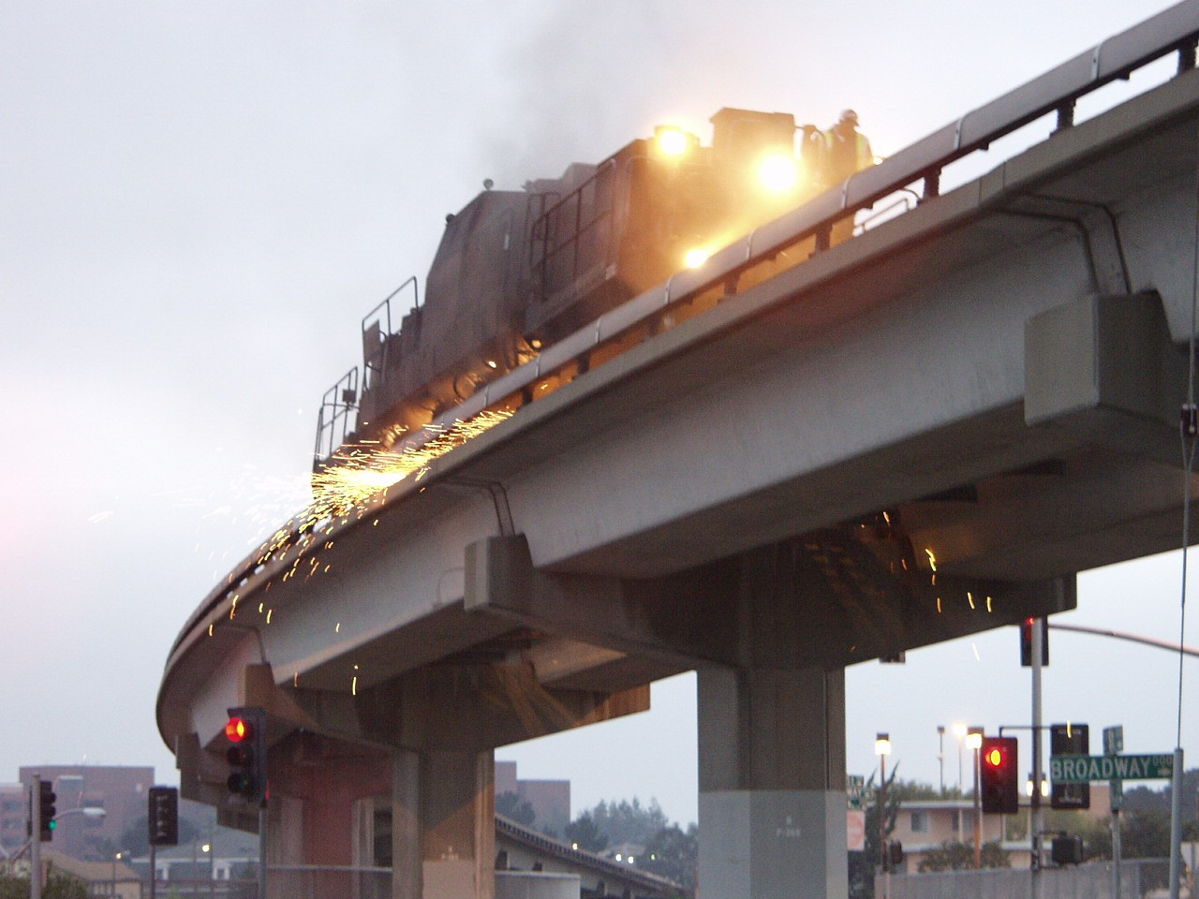
Track Impacts

Slide 10
Opportunity for Change
New Car Contract/ Bombardier
  Requirement of new car contract to resolve noise issue
  Collected data
    Laser measurements of the mainline – rail profile new and worn
    Measured wheel profiles new and worn
    Ran two instrumented wheelsets and trucks over entire system to understand ride quality requirements and dynamic characteristics of rail network
  Analyzed the data and confirmed poor wheel/rail interaction with pervasive 2 point contact resulting in excessive noise and severe wear
  Optimized simulations to develop custom tapered wheel profile

Slide 11
New Wheel Profile
  Several iterations to settle on custom BT-3 modified tapered wheel profile
  Special trackwork difficult to simulate

Slide 12
Evaluating Compatibility
  BART tasked ENSCO through LTK to evaluate BT-3 profile compatibility with special trackwork and to confirm acceptability system wide
    Dynamic mainline tests using 2 instrumented wheel sets modified with BT-3 profile wheels
    Track geometry and rail profile mapping of entire rail network
    Special trackwork compatibility analysis
    Computer simulation analysis to corroborate Bombardier analysis

Slide 13
New v. Old Wheel Profile

Slide 14
Wheel L/V Events

Slide 15
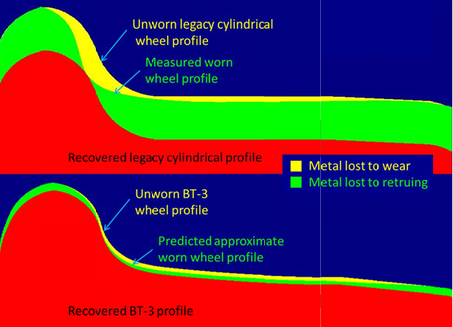
Benefit of BT-3 Modified Tapered Profile
  ENSCO and LTK confirmed operational benefits
    Safe
    Compatible with special trackwork
    Good stability and ride quality
  National Research Council Canada confirmed reduced wheel/rail wear
  Long term expectations
    Slower corrugation growth
    Less noise

Slide 16
Optimizing rail profile
  Overall wheel-rail profile objectives:
    Resistance to wear – strong steering capability, minimization of flanging forces
    Resistance to fatigue – control contact stresses to fall within the capability of the wheels and rail steels
    Resistance to corrugation development – avoiding conformal contact in tangent track, good steering in curves
    Minimization of L/V and truck forces – maximizing steering moments
    Maximization of stability – avoid conformal contact in tangent track
    Minimization of noise – avoiding flange contact, minimize corrugation development, minimize lateral slip in curves

Slide 17
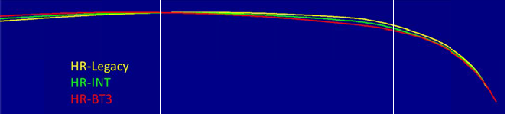
Design of New Rail Profile
  National Research Council Canada – designed rail templates
    Engineered rail (high, low, tangent) profile for average worn wheel
    Engineered optimal rail profile (high, low, tangent) for BT-3 wheel
    Evaluated the compatibility of each with the other wheel
    Developed transition profiles – intermediate and final BT-3 optimal

Slide 18
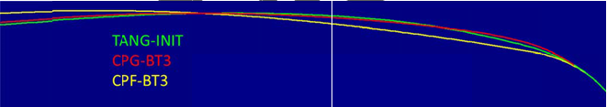
Transition Plan
  Bombardier, ENSCO and LTK helped refine transition strategy
    Cut all wheels to new profile over two years
    6 years to reach steady wear for both rail and wheel
    Grind for new rail profile based on new BT-3 wheel over 5 years
    Center profile gauge center profile field
 | %BT‐3 | High rails | Low rails | T1 tangent | T2 tangent
stage 1 | 0 | HR_int | LOW_int | TANG‐init | TANG‐init
stage 2 | 33 | HR_int | LOW_BT3 | CPG_BT3 | CPF_int
stage 3 | 66 | HR_BT3 | LOW_BT3 | CPG_BT3 | CPF_BT3

